Slide 1
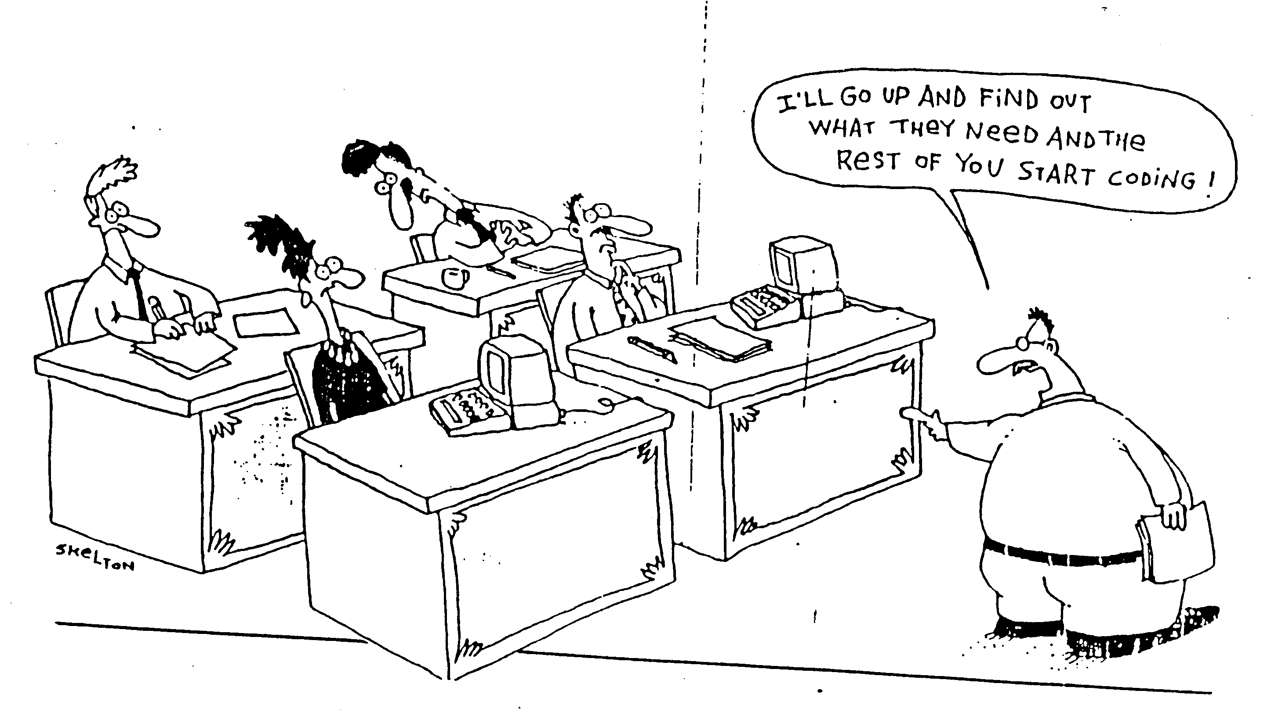
Current Practice for SW Development
SW developers have to follow systematic disciplines for building and analyzing software with high quality
This class focuses on the analysis activities
Notes:
-SW development cost takes 35% of total automotive production cost (Software Engineering for Automotive Systems Workshop, 2004)
-Due to complexity for reliable SW, the low productivity causes severe problem

Slide 2

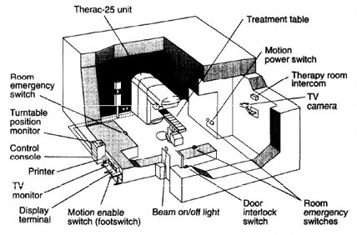
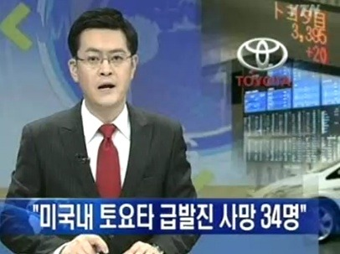
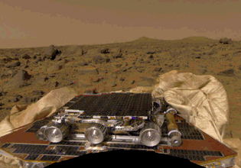
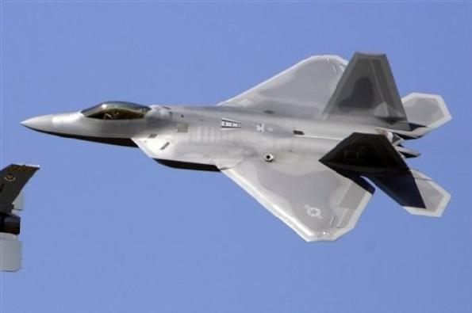
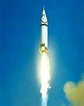
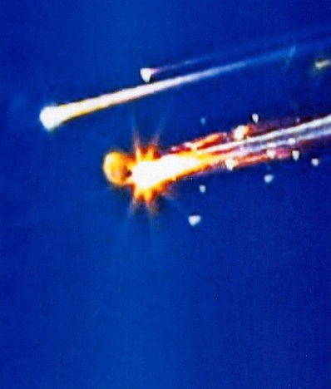
Safety Problems due to Poor Quality of SW

Slide 3
Tragic Accidents I
The Therac-25 Story
Between June 1985 and Jan 1987, a computer-controlled radiation therapy machine, called the Therac-25, massively overdosed six people
software coding error
http://sunnyday.mit.edu/papers/therac.pdf
Notes:
Reusing a shared variables for different purposes and a race condition on that variable led to a situation where lethal doses of radiation were given.
Several deaths resulted from this software error.
The Therac-25 accidents were fairly unique in having software coding errors involved—most computer-related accidents have not involved coding errors but rather errors in the software requirements such as omissions and mishandled environmental conditions and system states. Although using good basic software-engineering practices will not prevent all software errors, it is certainly required as a minimum

Slide 4

Tragic Accidents II
Ariane 5
“On 4 June 1996, the maiden flight of the Ariane 5 launcher ended in a failure…The failure of the Ariane 501 was caused by the complete loss of guidance and attitude information …This loss of information was due to specification and design errors in the software of the inertial reference system.”
Floating number conversion problem
http://www.ima.umn.edu/~arnold/disasters/ariane5rep.html
Notes:
Ariane 5 software reused old code from Ariane 4 that was not respecified and retested in new environment
Code in question performed floating point calculations
Ariane 5 (being more powerful than Ariane 4) caused unanticipated floating-point exception (which would have never occurred on Ariane 4), causing an exception to be thrown which was not caught
Triggered automatic destruction: $500 million loss

Slide 5
Tragic Accidents III
NASA Mars Pathfinder (1997)
Priority inversion problem led to a system reset and a one-day delay in retransmission of data which wasted valuable mission time.
http://www.cis.ksu.edu/~hatcliff/842/Docs/Course-Overview/pathfinder-robotmag.pdf

Slide 6
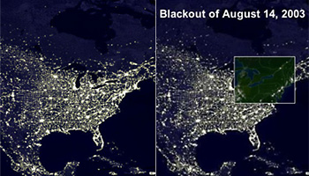
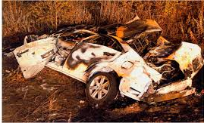
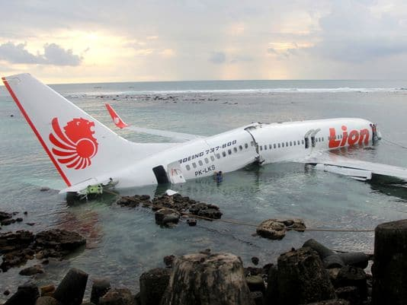




Social and Economic Loss due to High Complexity of SW
Although most areas of modern society depend on SW, reliability of SW is not improved much due to its high complexity
(2003) US & Canada blackout
7 states in US and 1 state in Canada suffered 3 days electricity blackout
Caused by the failures of MISO monitoring SW
50 million people suffered and
economic loss of 6 billion USD
(2010s) Toyota sudden unintended acceleration
89 people died since 2002
SW bugs detected in 2012
Fined 1.2 billion USD in 2014
(2018-2019) Boeing 737 MAX
accidents
346 people died in 2 accidents
SW bugs detected in 2019
Boeing 737 MAX is banned
all over the world
Notes:
20일 전자신문이 단독으로 입수한 바(BARR) 그룹의 도요타 급발진 조사보고서에 따르면, 캠리의 엔진 스로틀 컨트롤 시스템(ETCS)의 SW 결함이 급발진을 일으켰다. 보고서는 ETCS 전자제어장치(ECU)에 내장된 SW에 오류(버그)가 있었고, 오류가 있더라도 이를 커버해주는 방어수단(fail safes)도 작동하지 않았다고 지적했다.
바 그룹의 조사보고서는 지난해 10월 미국 오클라호마주 급발진 소송에서 도요타가 패소하는데 결정적 역할을 한 것으로 전해졌다. 도요타는 이 재판에서 피해자에게 300만달러의 손해배상금을 지급했다. 또 19일(현지시각) 도요타는 미국 법무부와 4년간의 급발진 관련 수사 종결에 합의하면서 벌금 12억달러(1조2800억원)를 부과받았다.
https://www.autoelectronics.co.kr/article/articleView.asp?idx=1513

Slide 7
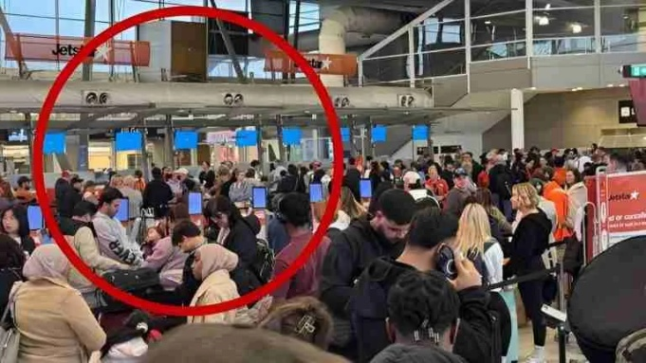
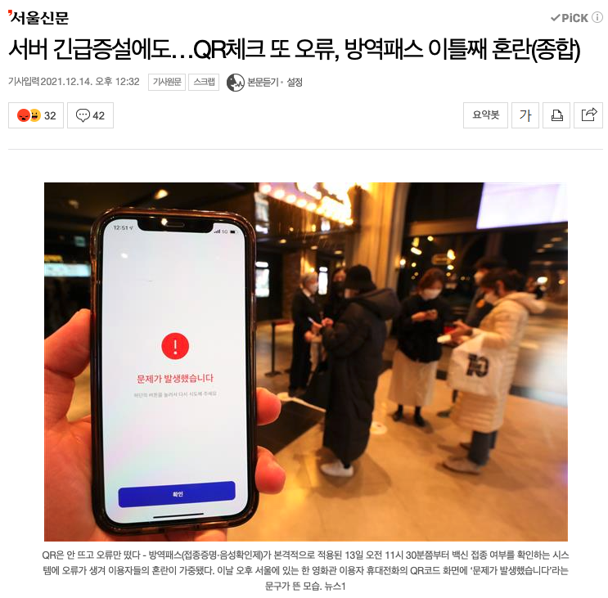
Software Failures
July 19, 2024 MS Cloud failure due to wrong update to CrowStrike security software
December, 2021 Failure of the QR check-in system
March 10, 2017 Unable to unlock Tesla cars due to the problem of service APIs
July 2, 2015 Casualty at the Volkswagen factory due to faulty movements of robot arms

Slide 8
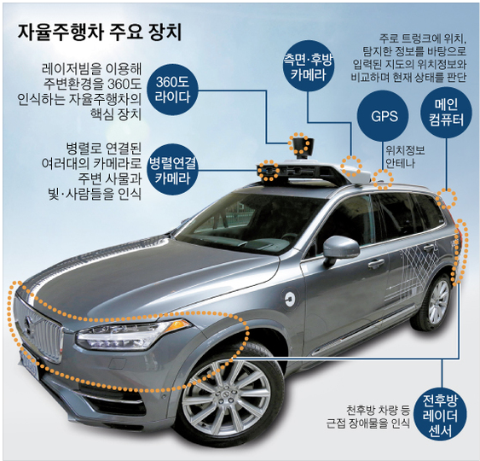
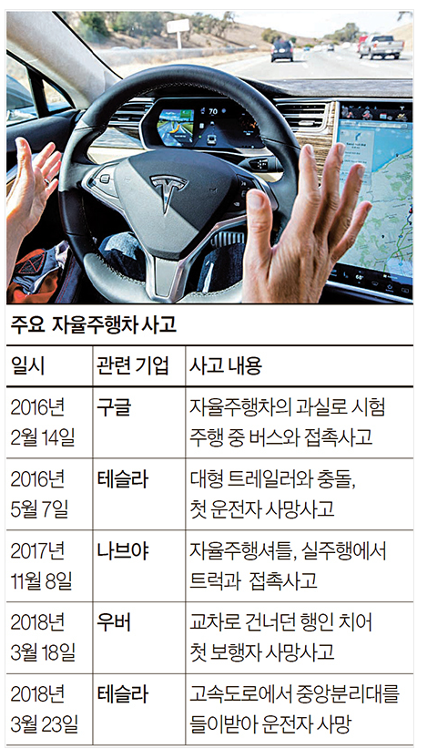
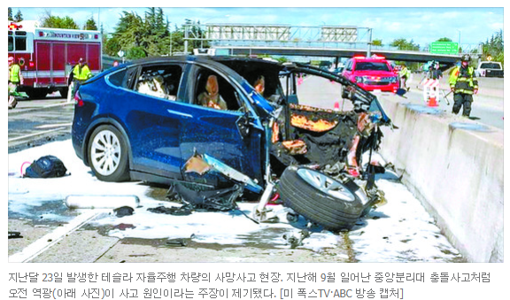
Accidents of Autonomous Vehicle
[출처: 중앙일보] “테슬라 사고, 태양 역광 탓” … 자율주행차 또 날씨 오작동

Slide 9
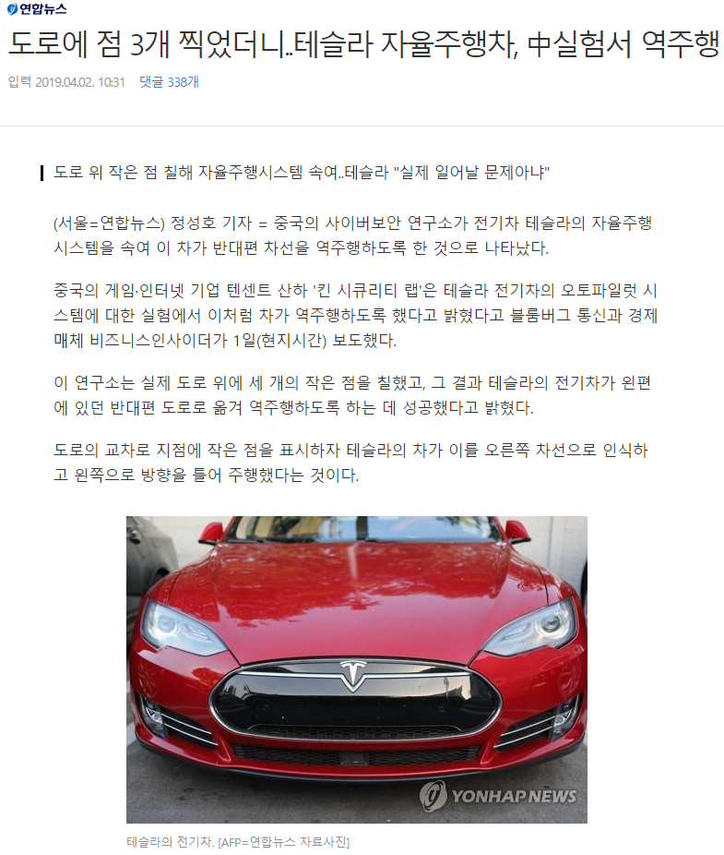
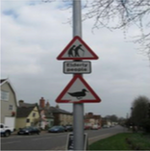
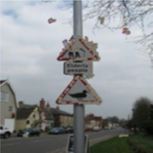
Bugs of Autopilot SW
The weakness of Data Driven AI/Machine Learning SW (adversarial example)
input image
(street sign)
Anomaly (bird nest)

Slide 10
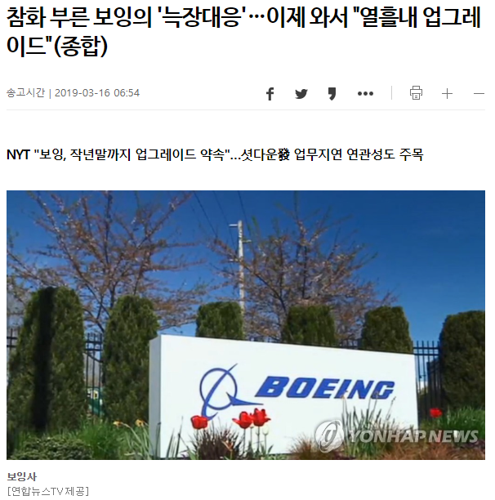
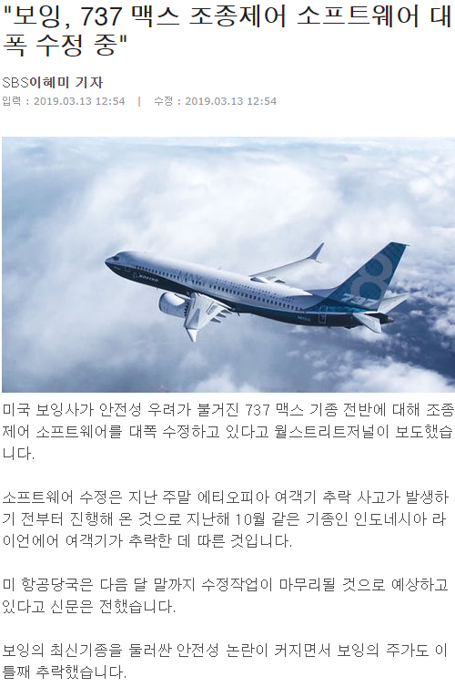
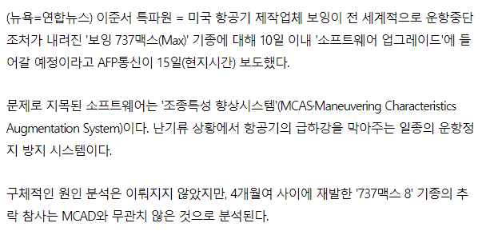
Boeing 737 MAX Crashes due to SW Bugs

Slide 11
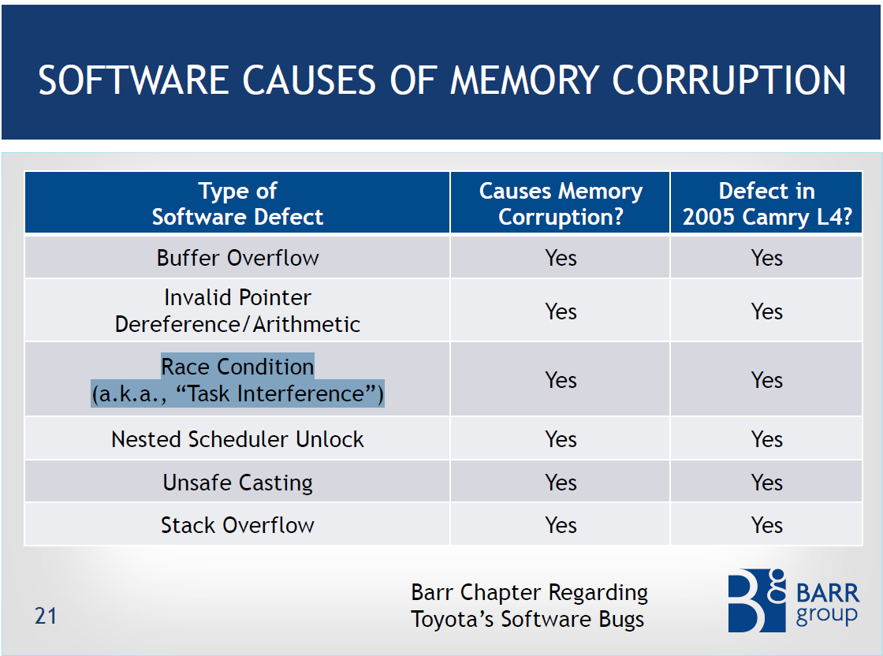
Static analysis falls short of detecting such complex bugs accurately
High false negatives
High false positives
Systematic and dynamic analysis (i.e. automated sw testing) is MUST for high quality SW

Slide 12
What is Software Engineering?
“Software engineering is the form of engineering that applies the principles of computer science and mathematics to achieving cost-effective solutions to software problems” [CMU-SEI]
“Software Engineering : (1) The application of a systematic, disciplined, quantifiable approach to the development, operation, and maintenance of software; that is, the application of engineering to software. (2) The study of approaches as in (1).” [IEEE]

Slide 13
Software Engineering Principles
Principles
“General and abstract statements describing desirable properties of software process and product”
Methods
“General guidelines that govern the execution of some activity; they are rigorous, systematic, and disciplined approaches”
Techniques
More technical than methods and have more restricted applicability
Methodologies
Sets of methods and techniques selected for solving a problem
Tools
Tools to support the application of methodologies
Tools
Methodologies
Methods and Techniques
Principles
Change rapidly
Change slowly
Relationship between principles, techniques, methodologies and tool
[GJM02] Ghezzi et al., Fundamentals of Software Engineering
Notes:
Give an example of each.
What is more visible to users, software developers?
Which one is easier to be changed?

Slide 14

Software Engineering Principles are for …
Understanding what to develop
Developing software the right way
Developing the right software
by effectively collaborating with
stakeholders, including
customers, users, and developers.
https://www.linkedin.com/pulse/go-digital-why-diverse-inputs-multi-stakeholder-feedback-chris-leong/

Slide 15
Topics to be Covered
Understanding what to develop
Introduction to Software Engineering
Software Requirements Engineering
Developing software the right way
Process Models: Heavy-weight process, Prototyping, Agile, DevOps,..
Basics of UML (Unified Modeling Language)
SE Principles: Separation of Concerns, Abstraction, Modularity, etc.
Software Design: Architectural Patterns, Resilient Design Patterns
Developing the right software
Software Quality: Correctness, Robustness, Safety, Security, etc.
Software Testing: Testing overview, Black-box and White-box testing

Slide 16
Readings
[PrMa20] Roger S. Pressman, and Bruce R. Maxim, Software Engineering – A Practitioner’s Approach, 9th Ed., Mc Graw Hill, 2020 (ISBN-13: 978-1259872976)
[Som11] Ian Sommerville, Software Engineering (9th edition), Addison-Wesley, 2011
[GJM02] Carlo Ghezzi, Mehdi Jazayeri, Dino Mandrioli, Fundamentals of Software Engineering (2nd edition), Pearson, 2002
[LeWi99] Dean Leffingwell and Don Widrig, Managing Software Requirements: A Unified Approach, Addison-Wesley, 1999 (ISBN: 0-201-61593-2)
[Coc01] Alistair Cockburn, Writing Effective Use Cases, Addison-Wesley, 2001
…

